Slide 1
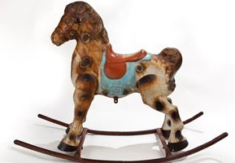
Writing a description
What?
What is the toy?
What does it look like?
What is it made of?
Why?
Why did you
choose this toy?
Where?
Where is it from?
Where is it kept?
How?
How is it used?
How does it work?
When?
Is it an old or new toy?
How old is it?

Slide 2
Grandad’s rocking horse
My grandad owned this old rocking horse 53 years ago when he was a little boy. His name is Dobbin.
He is made of metal and has brown spots painted on. You can sit on the red saddle and rock backward and forward.
I love riding Dobbin and that is why I chose this toy. He is at my house now and I ride him very fast and pretend I am racing!
How?
When?
Where?
Why?
What?
Notes:
Read each paragraph to the students and discuss what type of information it gives.
Paragraph 1 tells:
what the toy is
when Grandad owned it
Paragraph 2 tells:
what it is made from
what it looks like
how you use it
Paragraph 3 tells:
why the toy was chosen
where it is now
how it is ridden
While in Slide Show mode select the Pen in the bottom left-hand corner and select the highlighter. Work with students to highlight the how, when where and why and what information.

Slide 3
Text features
Grandad’s rocking horse
My grandad owned this old rocking horse 53 years ago when he was a little boy. His name is Dobbin.
He is made of metal and has brown spots painted on. You can sit on the red saddle and rock backward and forward.
I love riding Dobbin and that is why I chose this toy. He is at my house now and I ride him very fast and pretend I am racing!
Notes:
Slide 3 could be duplicated and used for such activities as:
discussing the punctuation
looking for words that represent people places and things (nouns and pronouns), happenings and states (verbs), qualities (adjectives) and details such as when where and how (adverbs).
rereading and suggesting improvements to the text.

