Slide 1
Social networking

Slide 2
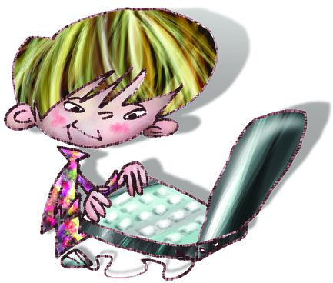
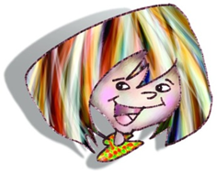
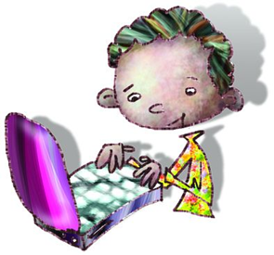
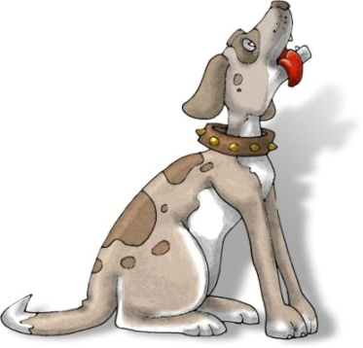
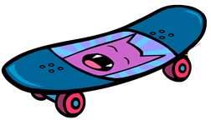
Social networking sites, like Facebook and MySpace, let you connect with family and friends using: blogs photos profiles internal email systems

Slide 3
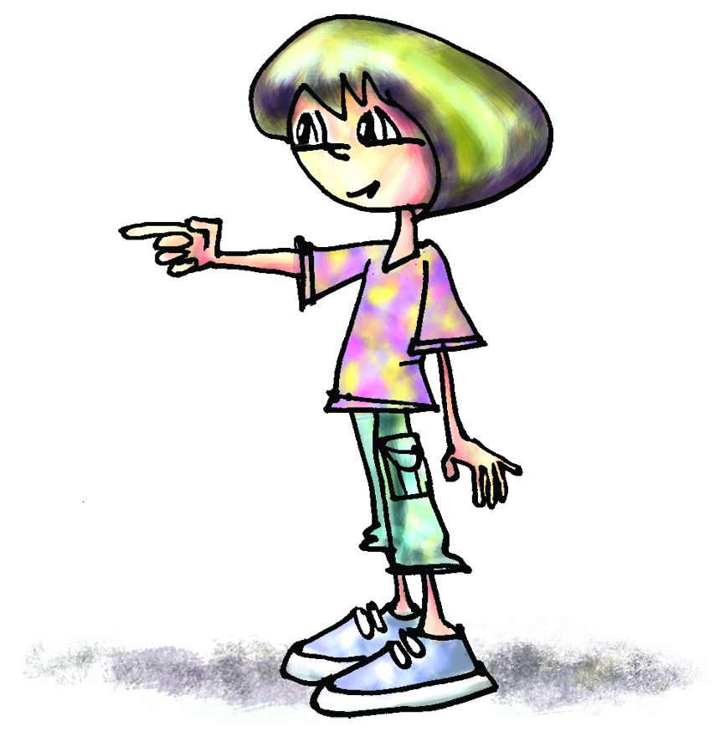
Your profile usually has headings like:
About me
Who I’d like to meet
Favourite music, films, sports
What I’m scared of
I’m happiest when ...
Personal details – appearance, hobbies

Slide 4
Your profile probably also has:
A default image that appears on your profile’s main page and next to your user name on comments and messages
A count of how many friends you have
A link to a page that lists all your friends
Music and videos that you have uploaded
Instant messenger where you can chat to your contacts

Slide 5
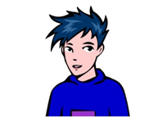
Keeping safe on social networks
You have a lot of personal information on your site, so make sure that you keep it safe!
Here are some things you can do:
Use an avatar instead of your photo.
Adjust your privacy settings so only approved friends can message you.
Don’t post your phone number or email address on your homepage.

Slide 6
Keeping safe on social networks
Don’t post pictures of yourself or your friends in school uniform.
Only upload pictures you would be happy for your family and friends to see as you can’t always control who will see your pictures.
Tick the ‘no pic forwarding’ option on your settings page so your pictures can’t be forwarded without your consent.

Slide 7
The Australian Government’s Cybersafety help and advice page shows you who to contact if you have seen something that has made you feel uncomfortable, scared or sad.

