Slide 1
Backyard shapes
Steps to make your backyard artwork

Slide 2
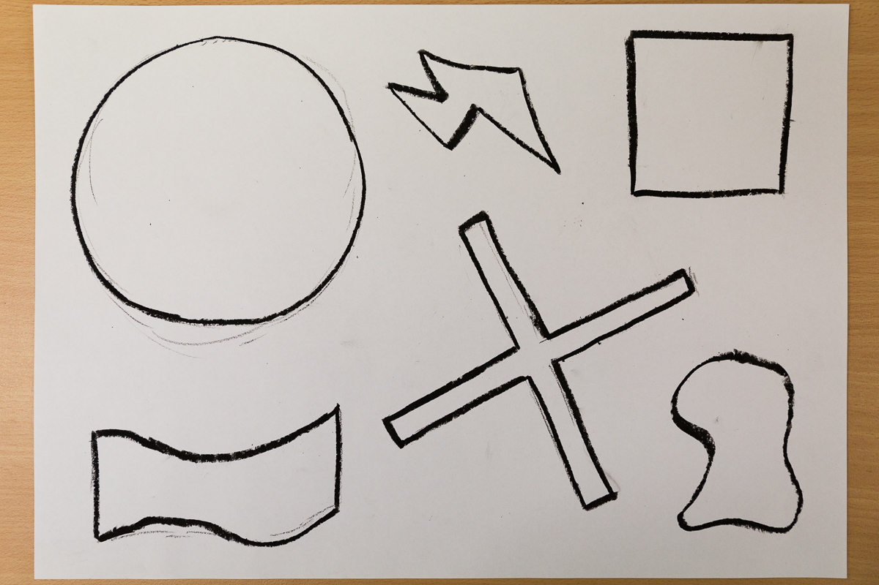
Slide 2
Imagine flying over your backyard or school playground. What shapes would you see? On a sheet of art paper use black oil pastel to draw the shapes with bold lines.

Slide 3
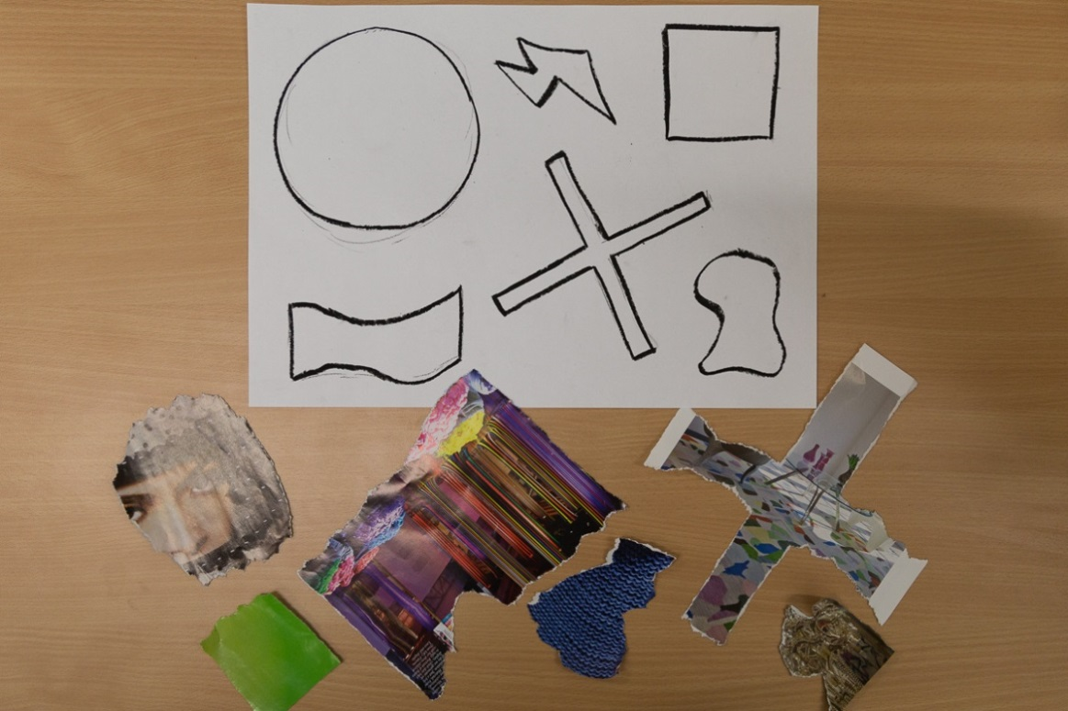
Slide 3
Tear (don’t use scissors) the shapes you have drawn from paper such as:
magazine pages
coloured paper
newspaper pages
print outs with text.
They don’t have to be the same size as the drawings and could be:
shades of one colour
black and white
varied colours.
Glue your shapes onto the page overlapping your drawing.

Slide 4
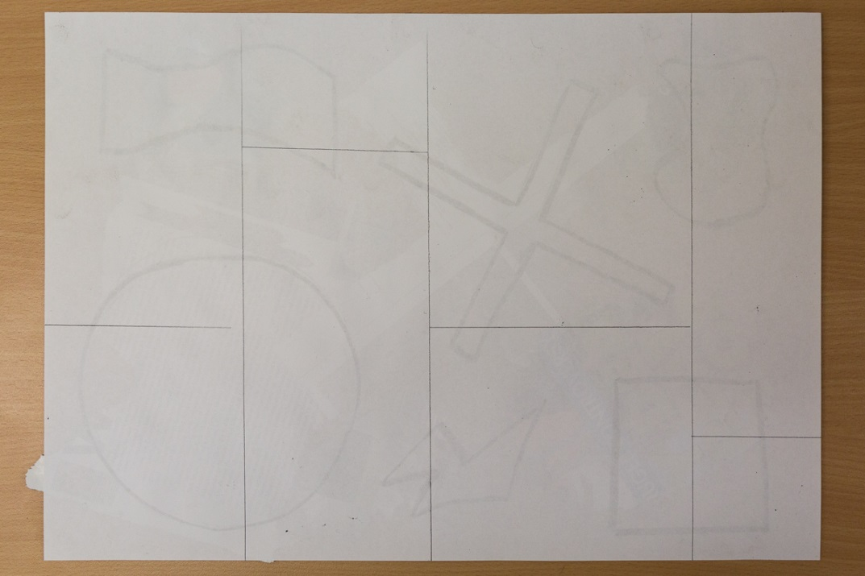
Slide 4
When dry turn the paper over and use a ruler to divide it into 6-10 rectangles. Cut these out. Shuffle the pieces then turn them over.
On a larger sheet of paper rearrange the pieces in an interesting composition. You could:
rotate pieces
join the pieces and/or leave spaces in between
place pieces in a grid or angle them over the page.
When you are happy with the composition glue the pieces down.

Slide 5
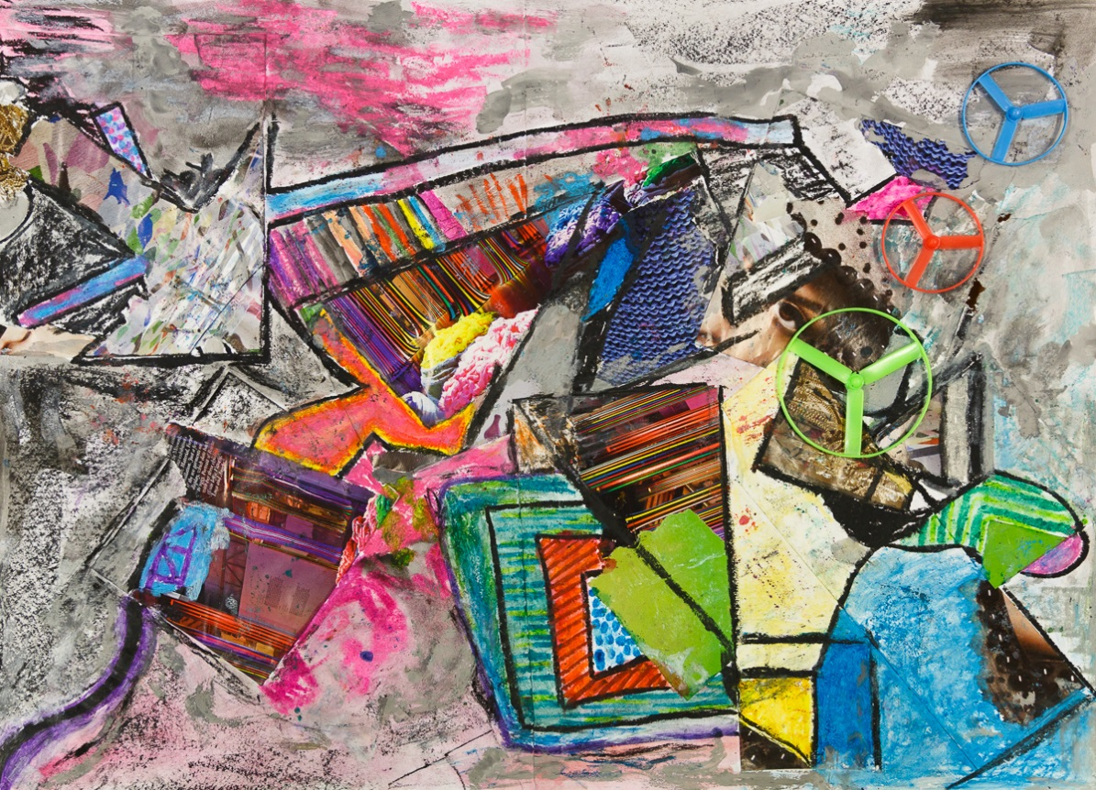
Slide 5
When dry, use artworks you studied as inspiration to complete your artwork.
You might work like:
Brett Whiteley, emphasising colour you find exciting and relevant to your landscape
John Olsen, adding lines and marks that lead the eye around the page
Colin Lanceley, adding three-dimensional objects
John Coburn, keeping the work simple with emphasis on the shapes.

Slide 6
Slide 6
Can you see the influences of Colin Lanceley and John Olsen?

Slide 7
Slide 7
As in Colin Lanceley’s painting, 3D objects have been included.
As in John Olsen’s painting, an arrow is used to draw the viewer into the painting.
Did you see these features?

Slide 8
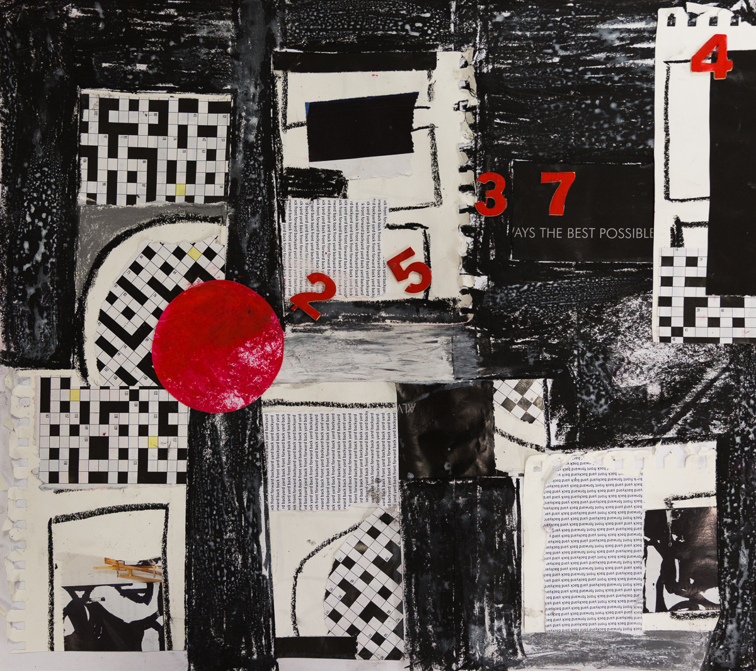
Slide 8
Can you see the influences of Colin Lanceley?

Slide 9
Slide 8
As in Colin Lanceley’s painting, 3D objects have been included.
As in Colin Lanceley’s painting a black background has been used.
Did you see these features?

